Slide 1
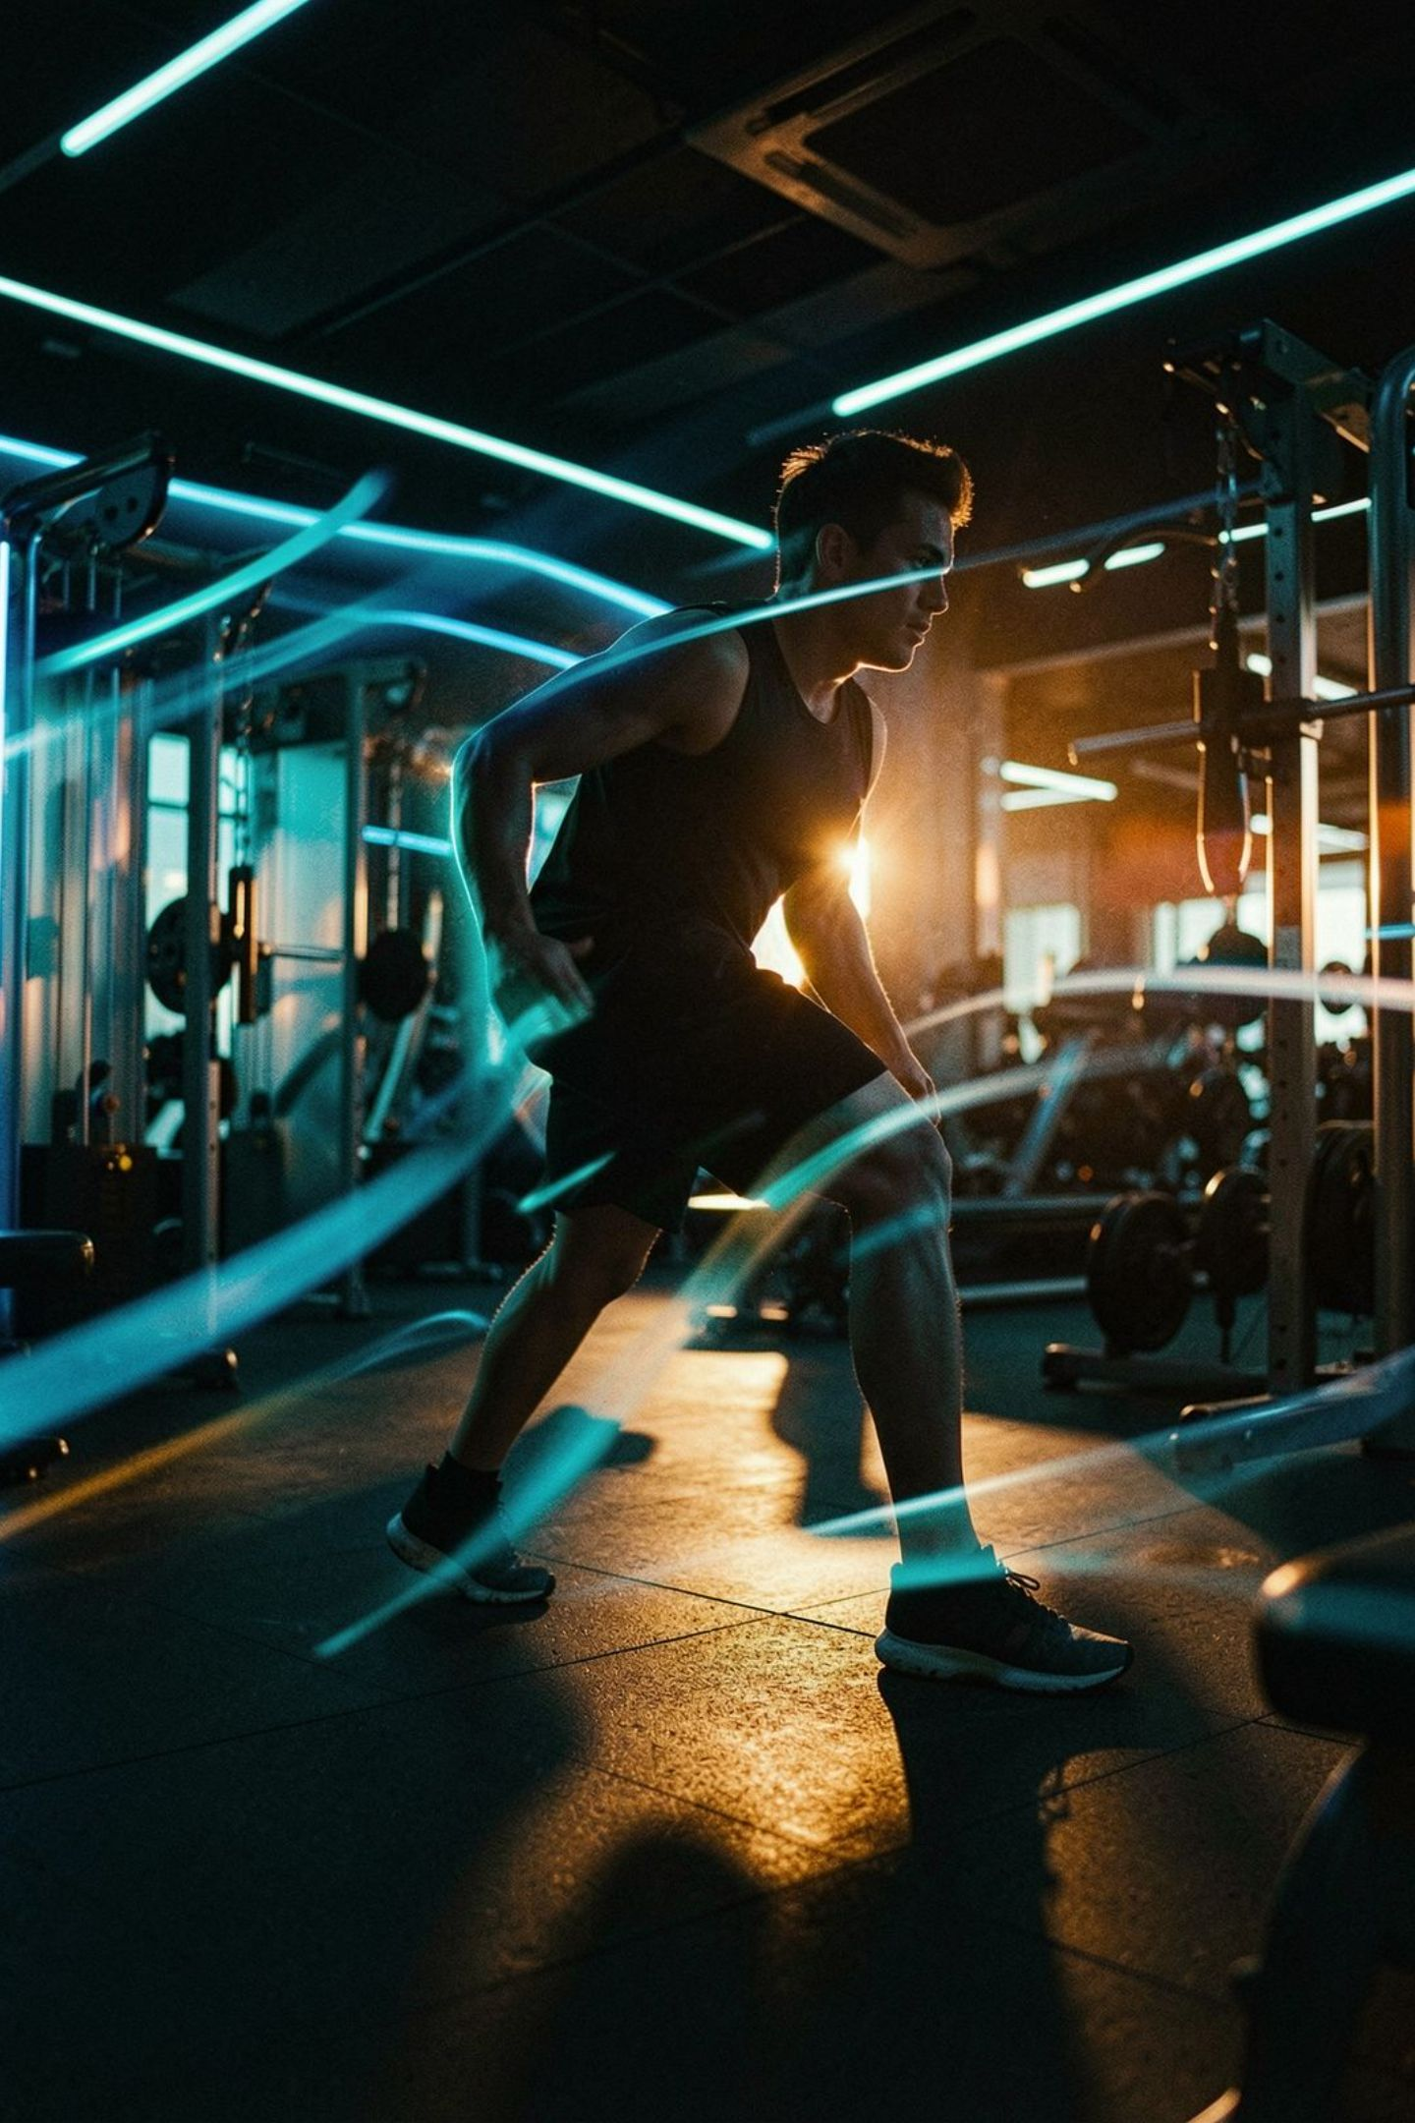

Pocket AI coaching today.
The largest aggregated gym network tomorrow.
AI Form Coach & Decentralized Gym Network

Slide 2

The Fitness Trilemma
Three systemic failures that FIZI solves simultaneously
💸 Prohibitive Cost
🩹 Injury & Plateau Epidemic
Personal training costs Rs.3,000–8,000 per session — locking out 65% of gym-goers from expert guidance.
67% of fitness app users abandon within 90 days — due to injury, plateau, or boredom from uncorrected bad form.
🏚️ Fragmented Gym Ecosystem
Thousands of private neighbourhood gyms run at 90% vacancy with zero digital booking or marketing tools.

Slide 3
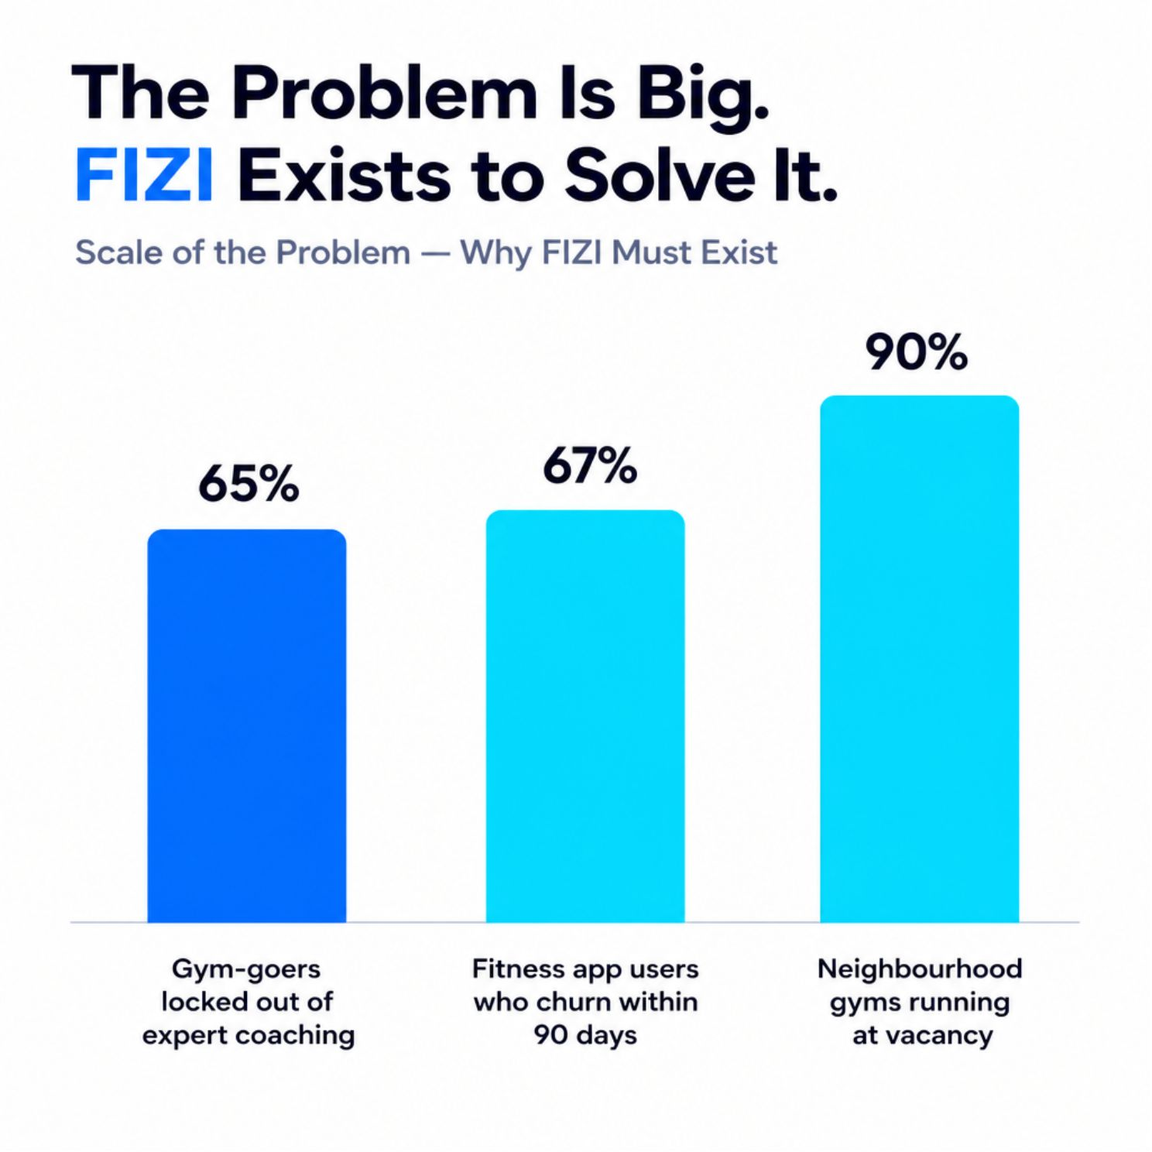
The Problem in Numbers
The scale of the opportunity hiding in plain sight
65% Locked Out
Gym-goers priced out of expert form guidance due to Rs.3,000–8,000/session personal training costs.
67% Churn Rate
Fitness app abandonment within 90 days — injury, plateau, and boredom from uncorrected biomechanics.
90% Vacancy
Neighbourhood gyms lose revenue to empty benches every single day — no digital tools, no discovery.

Slide 4
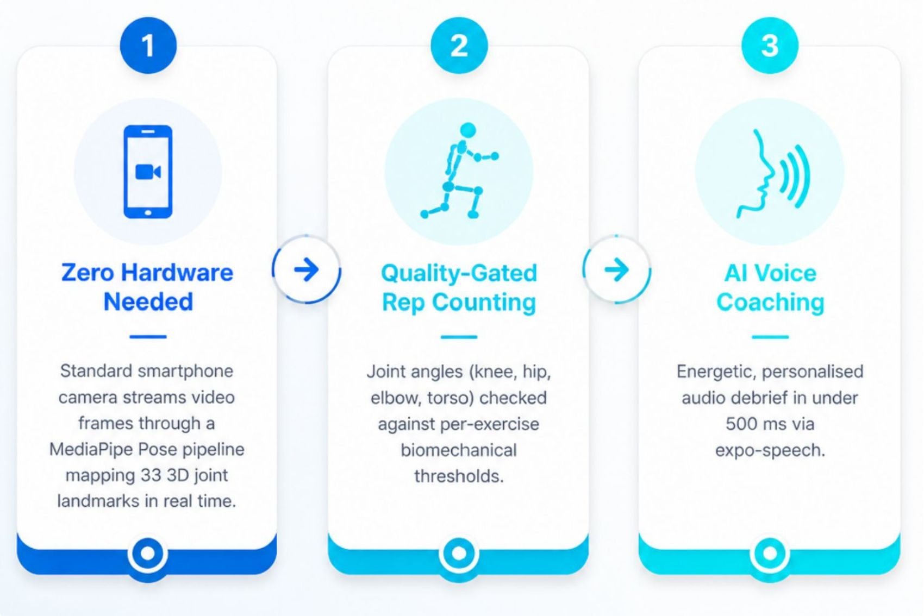
AI Computer Vision Form Coach
Turns any smartphone into an elite personal trainer — zero extra hardware required
1
Zero Hardware Needed
Standard smartphone camera streams video frames through a Pose pipeline mapping 33 3D joint landmarks in real time.
2
Quality-Gated Rep Counting
Joint angles (knee, hip, elbow, torso) checked against per-exercise biomechanical thresholds. A shallow squat is rejected — the rep counter does NOT increment.
3
AI Voice Coaching
Energetic, personalised audio debrief in under 500 ms via expo-speech. Users hear exactly what to improve before their next set.

Slide 5
Gamified Habit & Retention Engine
Behavioral design that transforms workouts into an addictive daily ritual
RPG Avatar Progression
SVG Muscle Radar Chart
Head-to-Head Comparison
Every clean rep earns XP. 7 tiers: Beginner → Starter → Regular → Dedicated → Athlete → Champion → Legend.
Custom-built radar chart tracks training volume across all 6 major muscle groups in real time — no third-party lib.
Compare volume, 1-Rep Max PBs, and muscle split balance against friends over 7 / 30 / 90 day windows.
Smart Nutrition Engine
24+ Achievements & Streaks
Automated BMR & TDEE calculation with personalized daily Protein/Carb/Fat macro breakdowns for Veg and Non-Veg diets.
Bronze, Silver, Gold milestone badges unlockable via real-time achievement toast notifications.

Slide 6
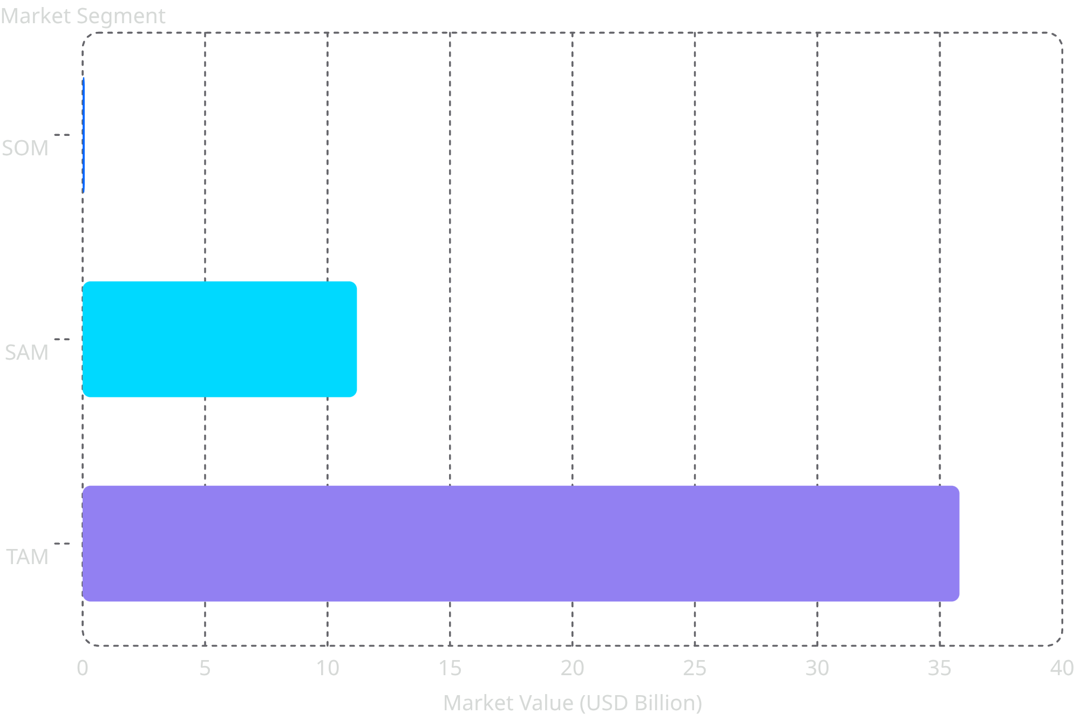
Market Opportunity: A USD 35.8 Billion Convergence
AI + Digital Health + Mobile Fitness + Hybrid Gym Across = all growing at 27.6% CAGR
Key Market Insights
17.6% CAGR
The global fitness market is growing rapidly faster than traditional sectors.
75% Tech Health Digitally
75% of health-conscious consumers now use digital fitness tools, apps, or wearables.
Home Gym Boom & Hybrid Fitness
Pandemic-driven shift to hybrid fitness without creating a permanent home gym setup.
Gym Aggregation Gap
Independent gyms lack digital discovery and booking tools — a massive untapped opportunity.
Gen-Z Millennial Boom
18-34 age group accounts for 45% of fitness spenders and has the highest willingness to pay for online products.
The global fitness market is projected to reach USD 35.8 Billion with a CAGR of 17.6%.

Slide 7
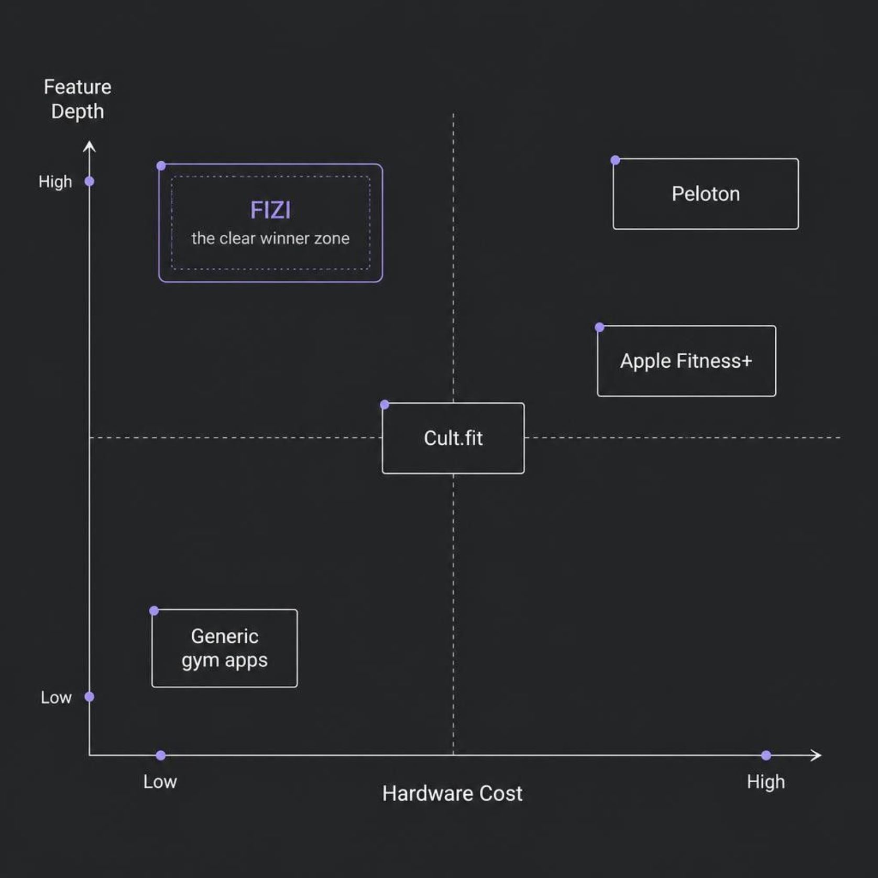
Competitive Landscape: Why FIZI Wins
FIZI's Unfair Advantages
AI Vision — No Hardware
Peloton requires $1,500+ equipment. FIZI works on any smartphone already in your pocket.
Social RPG Retention
No competitor combines gamified XP progression with head-to-head peer comparison at this price point.
Gym Marketplace (Phase 2)
A decentralized gym network layer that no pure-software competitor can replicate without massive capex.
India-First Pricing
Rs.299/quarter vs. $15+/month globally — unlocking a 95% gym-goer segment priced out of existing solutions.

Slide 8
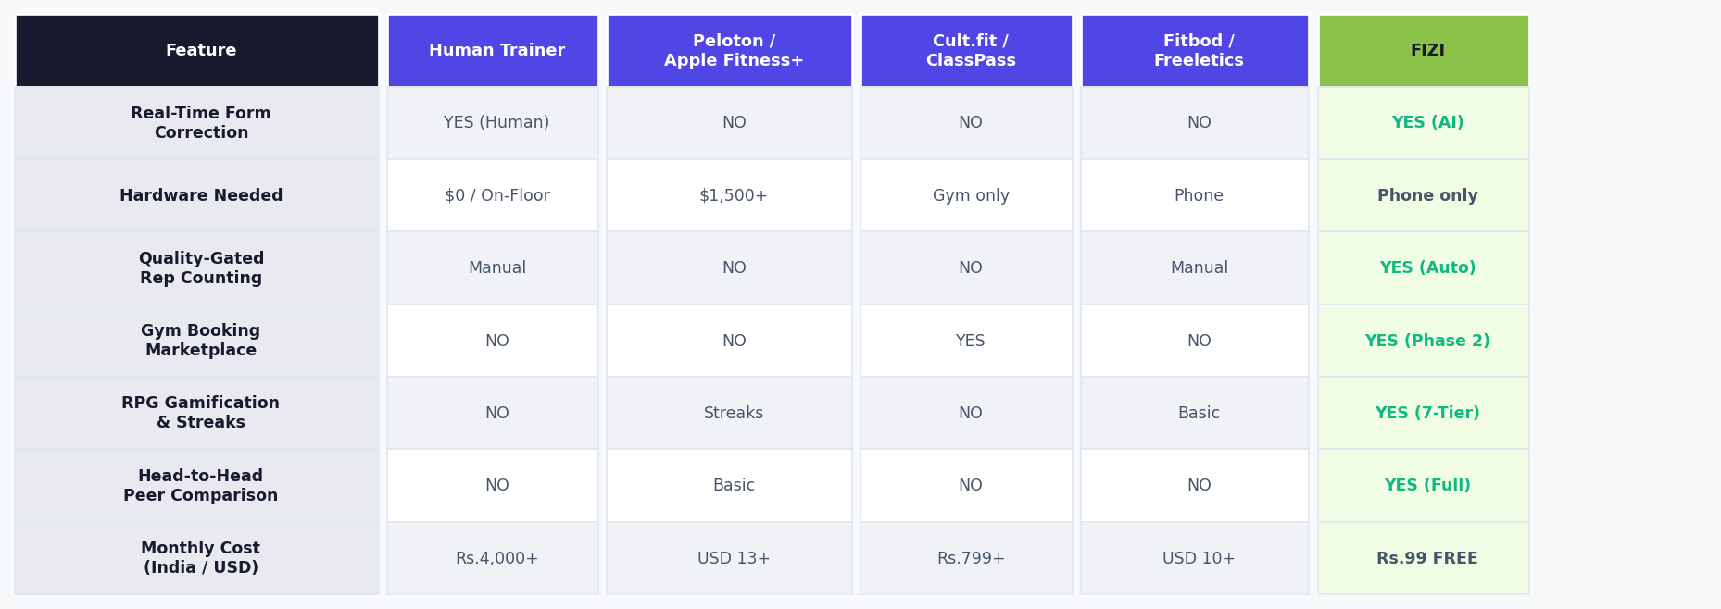
Incumbent Blind Spot
Cult.fit Limitation
FIZI's Unique Position
Peloton and Apple Fitness+ are married to expensive hardware ecosystems. They cannot serve the 95% without a USD 1,500+ device.
Cult.fit only works with its own chain studios. It leaves thousands of independent private gyms completely untouched by digital tools.
FIZI is the only solution delivering real-time AI form correction + social gamification + a gym booking marketplace at an affordable price — on any smartphone.

Slide 9
Phase 1 Monetization: High-Margin Consumer SaaS
Freemium viral flywheel → FIZI Pro subscriptions → 88%+ gross margin
🆓 FREE TIER
⚡ PRO QUARTERLY
🏆 PRO ANNUAL
300+ exercise library (5 categories)
Live AI camera form coach
Manual workout logging & history
Basic habit streak tracking
Community feed, posts & likes
Explore other users & follow
Rs.299 / ~USD 4.00
Rs.799 / ~USD 15–25
Smart nutrition & macro planner
Priority AI coach access
Head-to-head friend comparison
Unlimited custom weekly routines
Full analytics dashboard
Auto-adaptive AI workout plans
Advanced body composition metrics
Early access to Phase 2 gym passes
All Pro Quarterly features included
88%+
$18
9:1
Software Gross Margin
Blended ARPU / Year
LTV to CAC Ratio

Slide 10
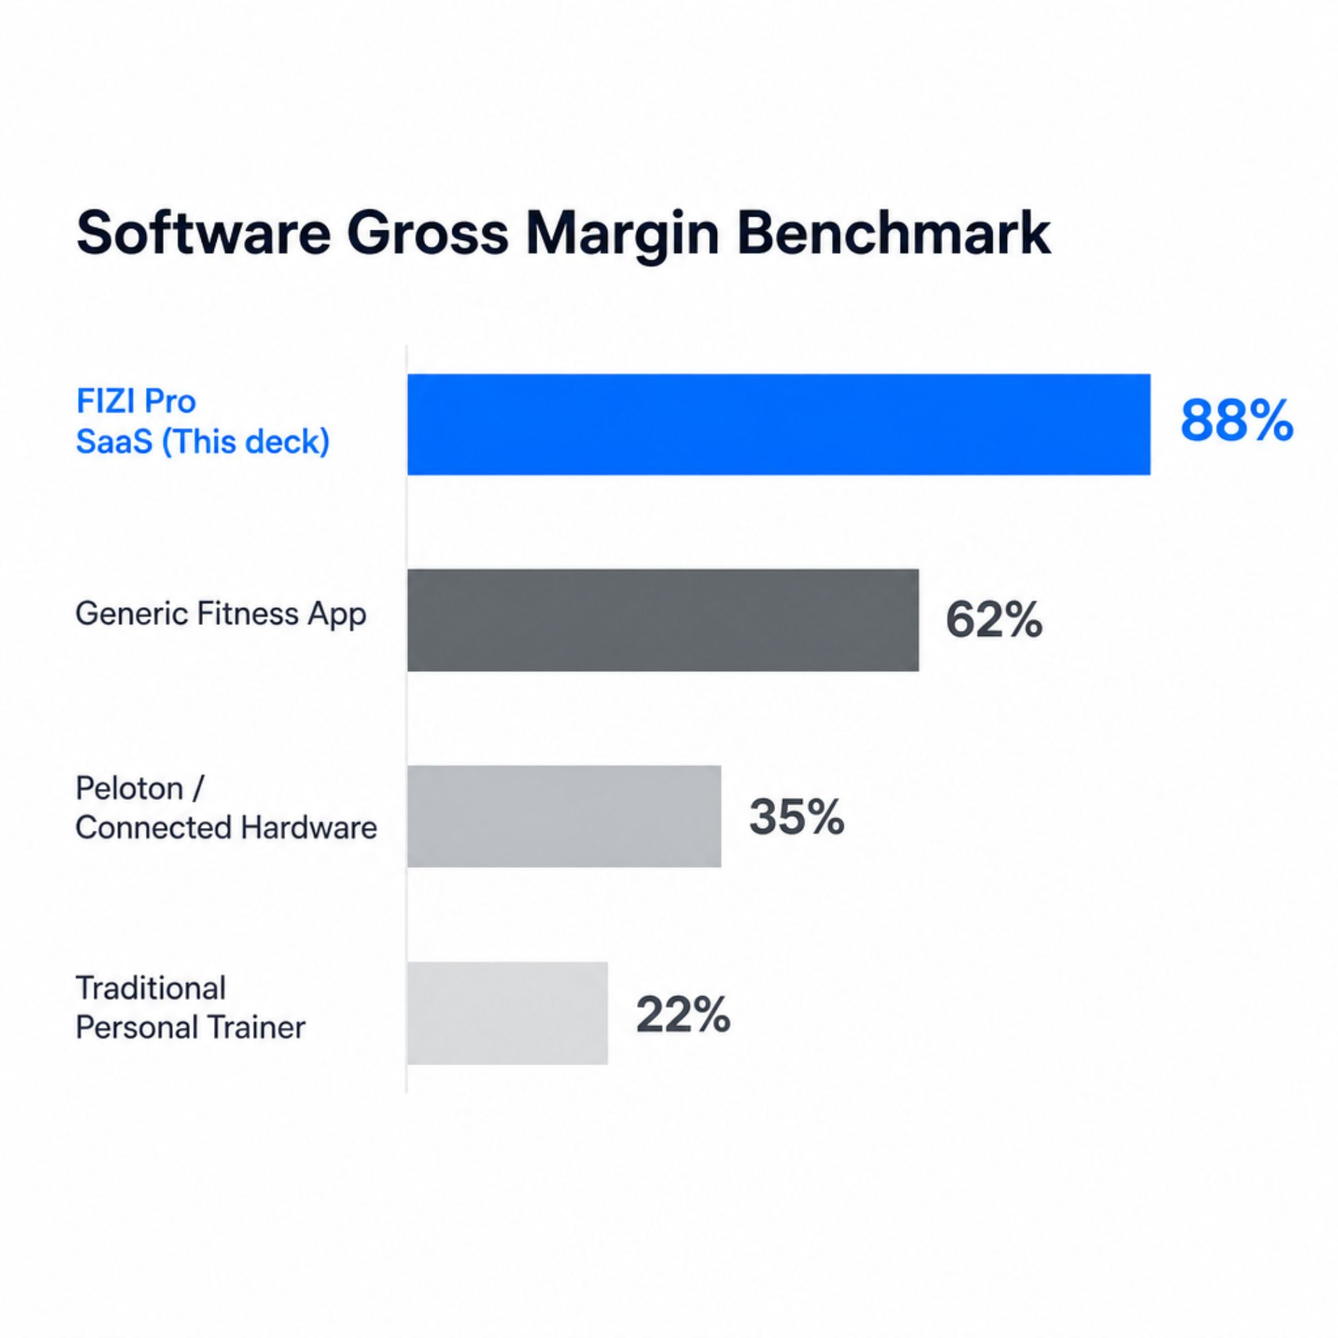
Pricing & Unit Economics
Why the Economics Work
FIZI's software-first model means near-zero marginal cost per user. The freemium flywheel drives organic acquisition while Pro conversions generate compounding recurring revenue.
Metric | Value
Software Gross Margin | 88%+
Blended ARPU / Year | USD 18
LTV : CAC Ratio | 9 : 1
Pro Quarterly Price | Rs.299 (~USD 4.00)
Pro Annual Price | Rs.799 (~USD 15–25)

Slide 11
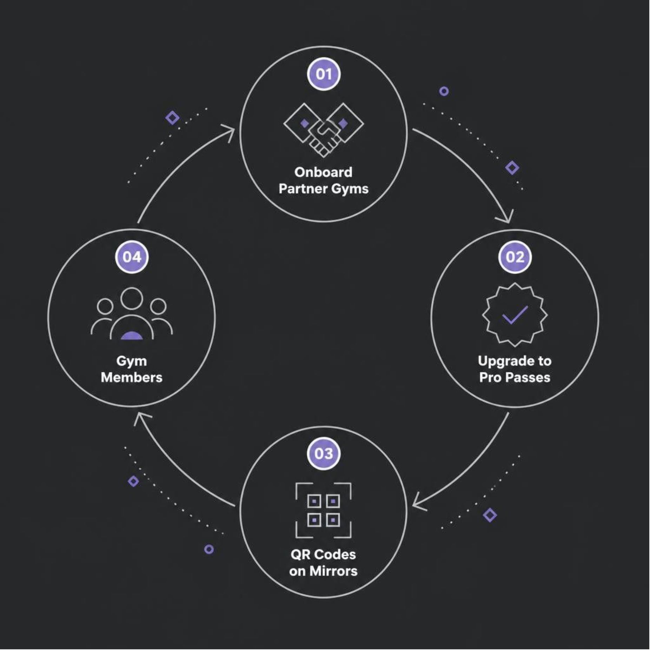
The Marketing Moat: Zero-CAC Ground Acquisition
FIZI's Unfair Acquisition Advantages
Mirror & Equipment QR Codes
Powered by FIZI - Scan to check your squat form. QR decals on mirrors, barbell racks, and cable machines. Every piece of equipment becomes a zero-cost FIZI acquisition touchpoint.
Front-Desk Digital Check-In
Partners replace paper sign-in sheets with FIZI digital passes. Every check-in surfaces a personalised workout recommendation, nudging gym-goers to upgrade to FIZI Pro.
Slashes CAC by 70%+
Traditional fitness apps pay USD 8-30 per install on Meta and Google. FIZI acquires high-intent, active athletes directly on the gym floor at virtually USD 0 CAC — a structural, defensible moat.
Self-Reinforcing Growth Loop
More gyms > more free downloads > more FIZI Pro upgrades > more gym pass bookings > more gym partners want to join. The flywheel compounds at scale.
1
Onboard Partner Gyms
2
Upgrade to Pro Passes
3
QR Codes on Mirrors
4
Gym Members

Slide 12



Scaling — Phase 2: Decentralized Gym Marketplace
ATHLETE / USER APP
FIZI MARKETPLACE
PARTNER GYM NETWORK
Users discover, compare, and book monthly memberships or single day-passes at hundreds of local partner gyms — all directly within the FIZI app. One pass. Multiple gyms. Maximum flexibility.
FIZI retains a 10%-15% take-rate on every booking. Average membership: Rs.2,000/month (~USD 25). FIZI net: ~Rs.250-300 (~USD 3.12) per active booking. No inventory risk. No equipment purchase. Zero capex.
Unlike Cult.fit (which leases studios) or Equinox (capex-heavy), FIZI never owns real estate or buys equipment. We monetize existing, underutilised gym infrastructure and scale purely through software and partnerships.

Slide 13
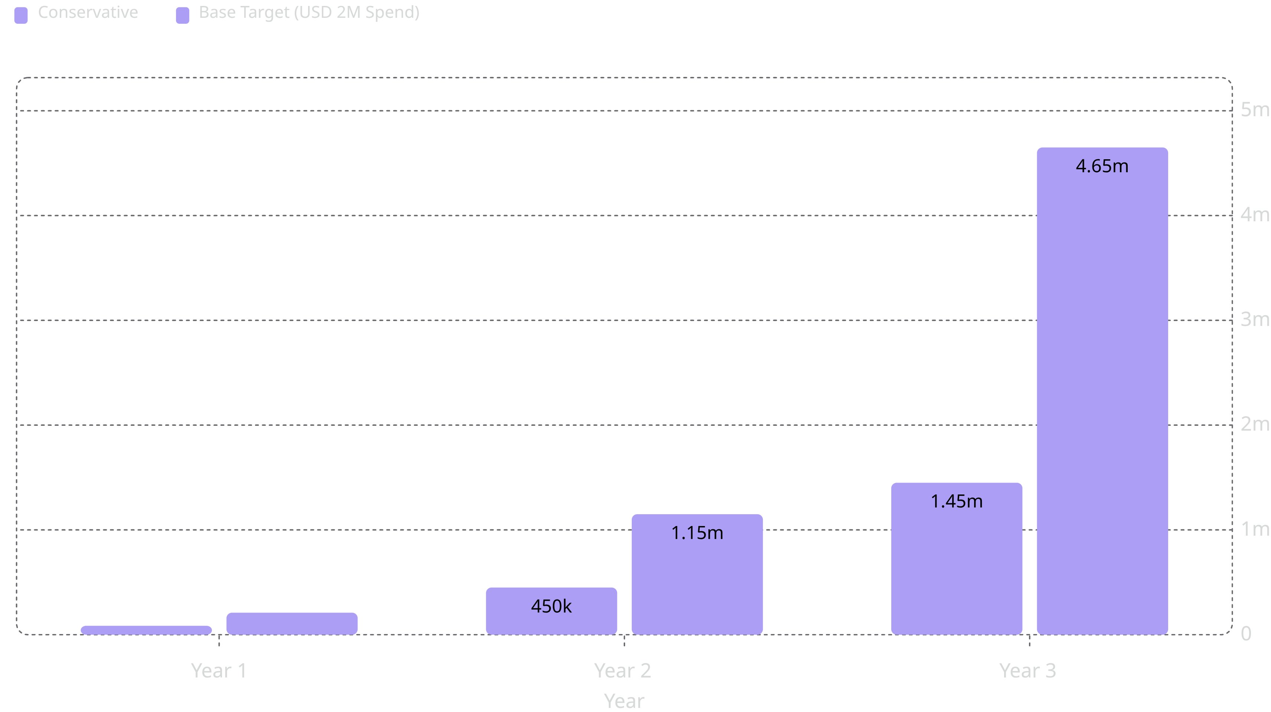
Financial Trajectory: 3-Year Multi-Scenario Model
Compounding App SaaS ARR + Gym Marketplace Commission GMV | All values in USD
$4.65M
55x
Base Target
Growth
Year 3 revenue outcome
Conservative Year 1 to Year 3
Scenario outlook
Conservative case
Base target
Measured adoption with disciplined execution and efficient spend.
Underwrites the proposed USD 2M seed round and scales into $4.65M by Year 3.
Milestones to scale
01
02
03
Year 1
Year 2
Year 3
Prove product-market fit and establish repeatable traction.
Expand distribution and improve partner economics.
Compound revenue across the core stack and accelerate scale.

Slide 14

The Ask: USD 2M Seed Round
Product & Engineering
Growth & Acquisition
Scale AI pipeline, Phase 2 gym marketplace build-out, and platform infrastructure.
Paid and organic user acquisition targeting the 95% of gym-goers underserved by existing solutions.
Gym Partner Network
Team Expansion
Onboard neighbourhood gyms onto the FIZI marketplace — converting 90% vacancy into booked revenue.
Hire senior AI/ML engineers, growth leads, and city-level gym partnership managers across India.
FIZI's mission: Make elite coaching accessible to every gym-goer in India — and eventually, the world. Join us in building the infrastructure layer for the future of fitness.

